Slide 1
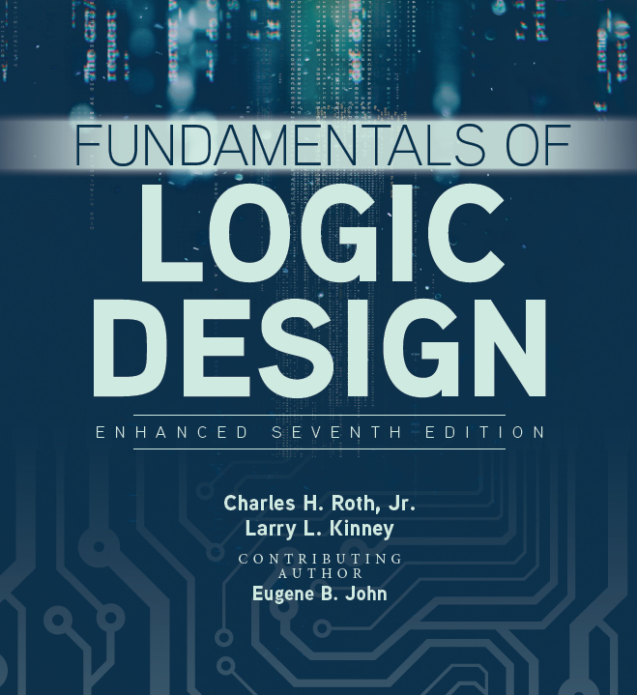

Sequential Circuit Design

Slide 2
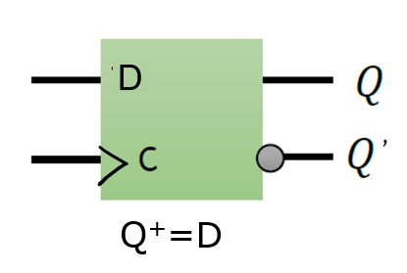
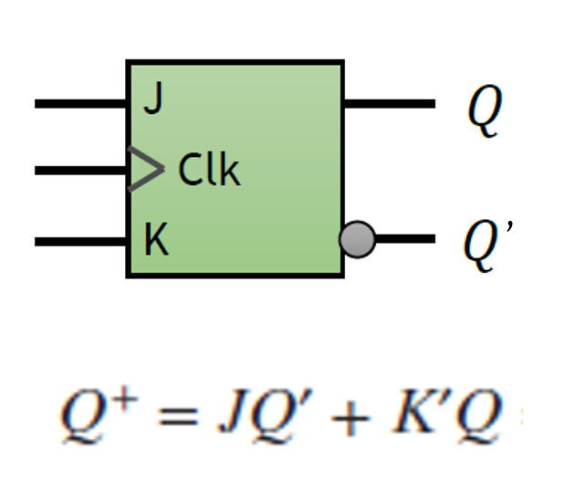
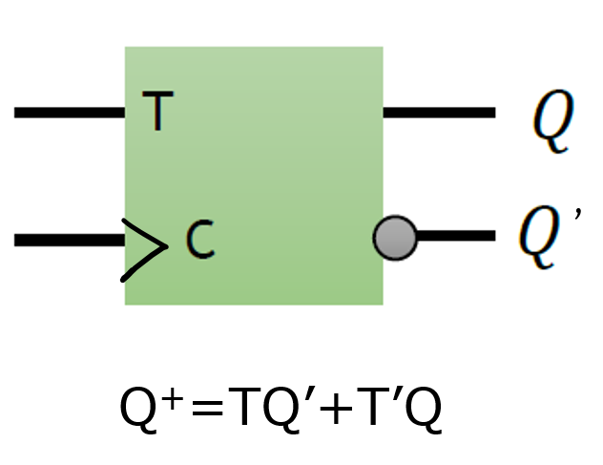
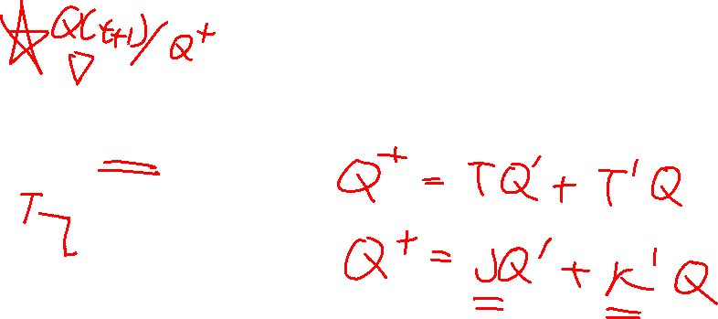
Review of last class
Use D flip flop or JK flip flop to design T flip flop

Slide 3
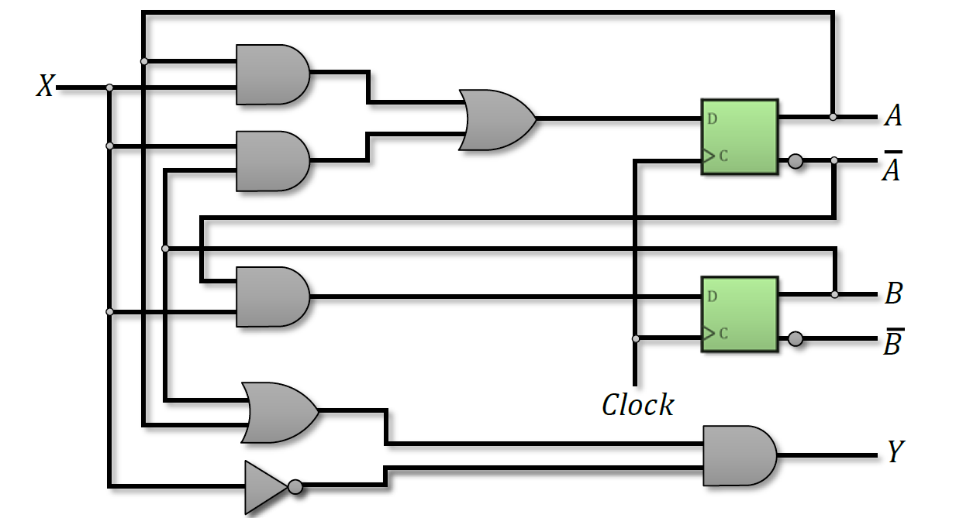
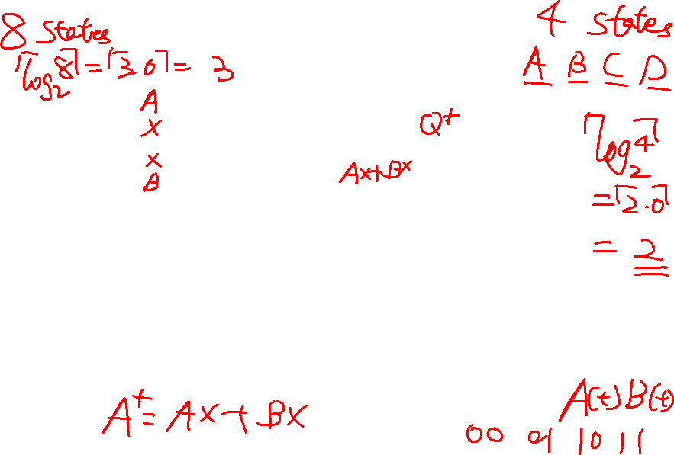
Review of last class

Slide 4
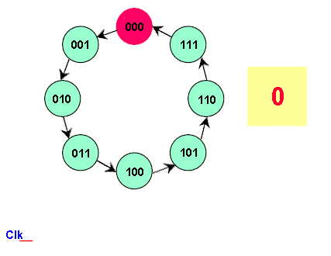
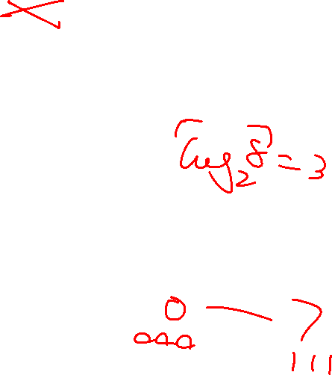
Design of 7 bits counter
Design a three-bit counter consisting of three T flip-flops
that can count in binary form from 0 to 7

Slide 5

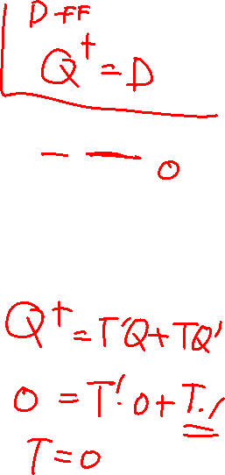
Present state |  |  | Next state |  |  | Flip-Flop Inputs
A | B | C |  |  |  | T_{A} | T_{B} | T_{C}
0 | 0 | 0 | 0 | 0 | 1 | 0 | 0 | 1
0 | 0 | 1 | 0 | 1 | 0 | 0 | 1 | 1
0 | 1 | 0 | 0 | 1 | 1 | 0 | 0 | 1
0 | 1 | 1 | 1 | 0 | 0 | 1 | 1 | 1
1 | 0 | 0 | 1 | 0 | 1 | 0 | 0 | 1
1 | 0 | 1 | 1 | 1 | 0 | 0 | 1 | 1
1 | 1 | 0 | 1 | 1 | 1 | 0 | 0 | 1
1 | 1 | 1 | 0 | 0 | 0 | 1 | 1 | 1
A⁺
B⁺
C⁺
Q(t) | Q(t+1) | T
0 | 0
0 | 1
1 | 0
1 | 1

Slide 6

0-7 counter
Present state |  |  | Next state |  |  | Flip-Flop Inputs
A | B | C |  |  |  | T_{A} | T_{B} | T_{C}
0 | 0 | 0 | 0 | 0 | 1 | 0 | 0 | 1
0 | 0 | 1 | 0 | 1 | 0 | 0 | 1 | 1
0 | 1 | 0 | 0 | 1 | 1 | 0 | 0 | 1
0 | 1 | 1 | 1 | 0 | 0 | 1 | 1 | 1
1 | 0 | 0 | 1 | 0 | 1 | 0 | 0 | 1
1 | 0 | 1 | 1 | 1 | 0 | 0 | 1 | 1
1 | 1 | 0 | 1 | 1 | 1 | 0 | 0 | 1
1 | 1 | 1 | 0 | 0 | 0 | 1 | 1 | 1
T
AB
A
A⁺
B⁺
C⁺
C
00 01 11 10
0
1
T
AB
B
C
00 01 11 10
0
1
AB
C
00 01 11 10
T_{C}
0
1

Slide 7
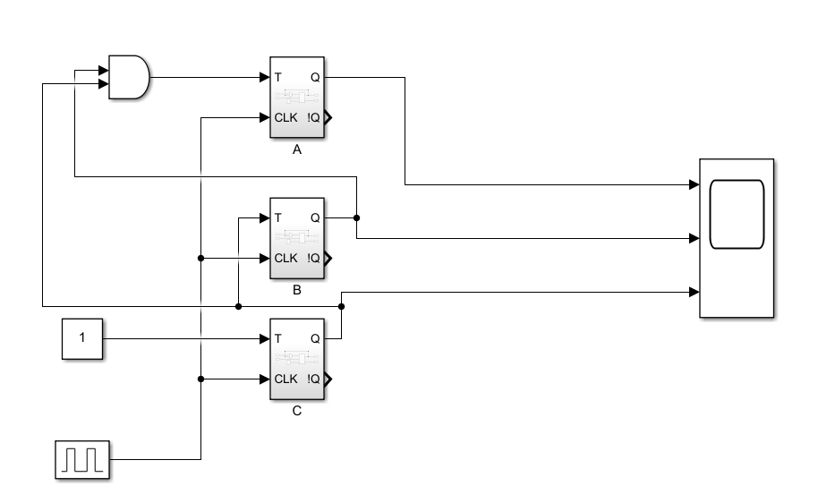
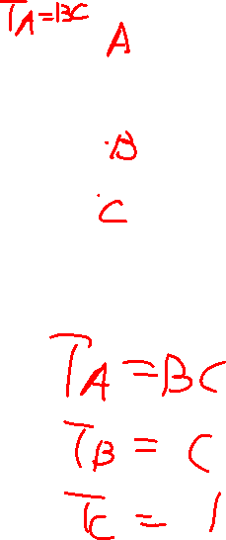

Slide 8
State table
The table consists of present state, input, next state and output
The next-states and the output values are then determined from the logic diagram or state equations for each possible binary combination of the input and the present state

Slide 9
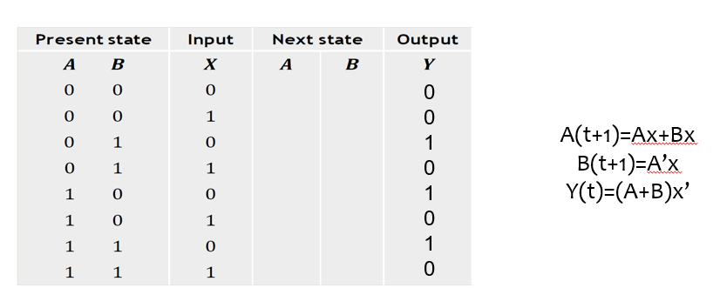

State table

Slide 10
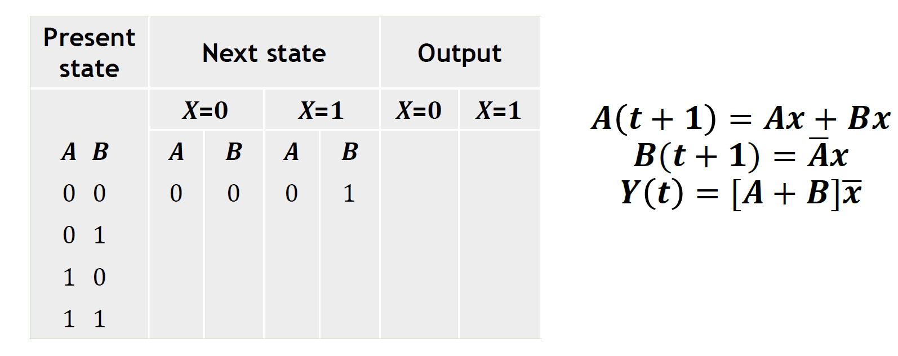
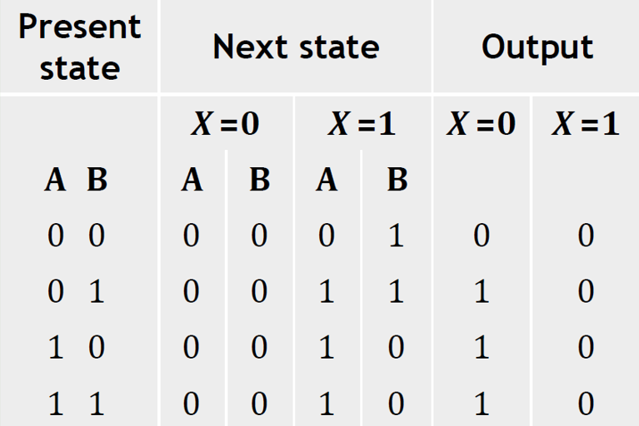

State transition
The state transition can be conveniently expressed in a slightly different form having only three sections: present state, next state and output
A(t+1)=Ax+Bx
B(t+1)=A’x
Y(t)=(A+B)x’

Slide 11
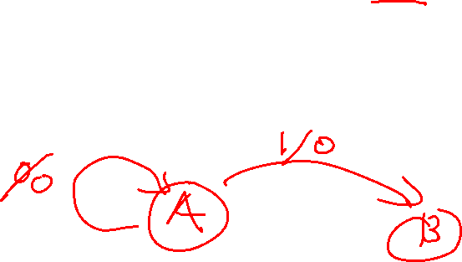
State diagram
The information available in state tables can be represented graphically in the form of a state diagram
In a state diagram, a state is indicated by a circle and the transitions between the states are represented by directed lines connecting the circles. The directed lines are labeled with two binary numbers separated by a slash. The first binary number is for the input value and the second number shows the output value for the given input value

Slide 12
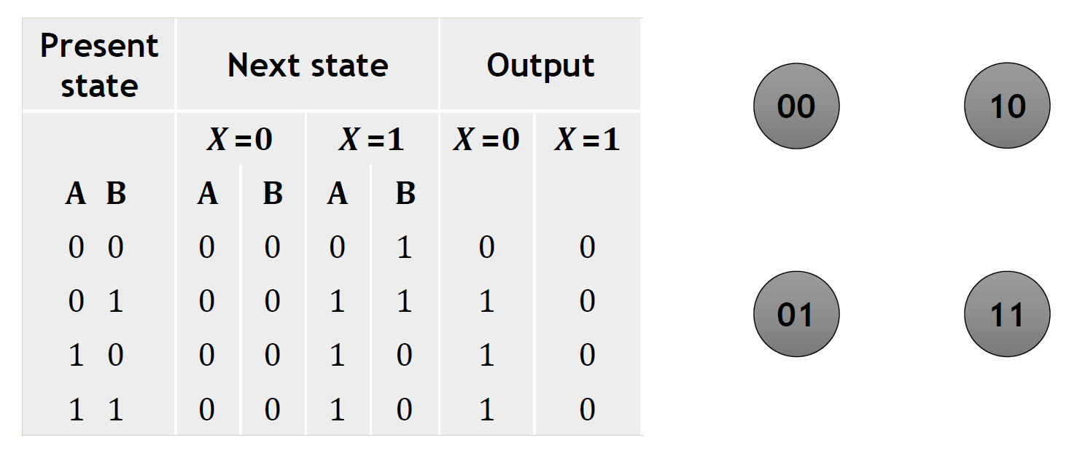
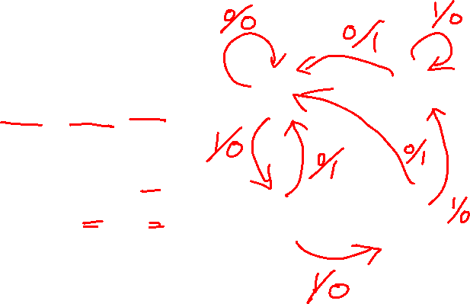
State Diagram
State diagrams provides pictorial representation that is easier for human representation.

Slide 13
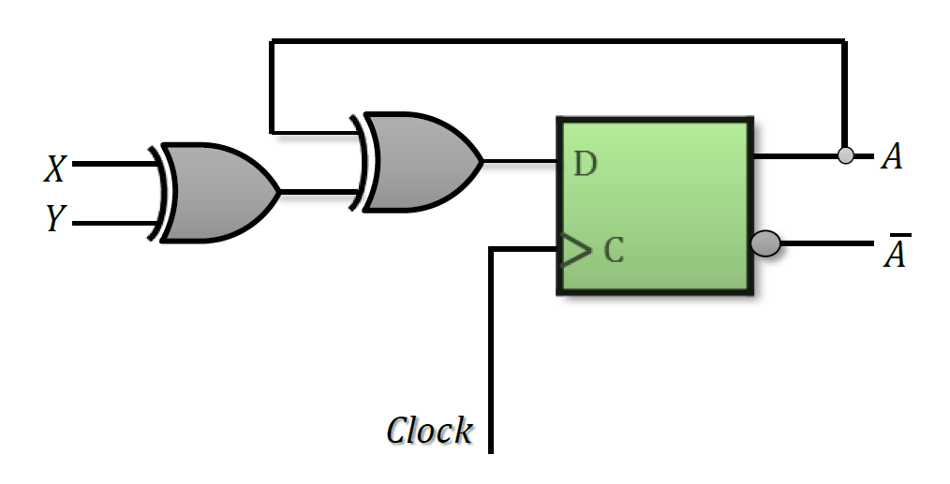
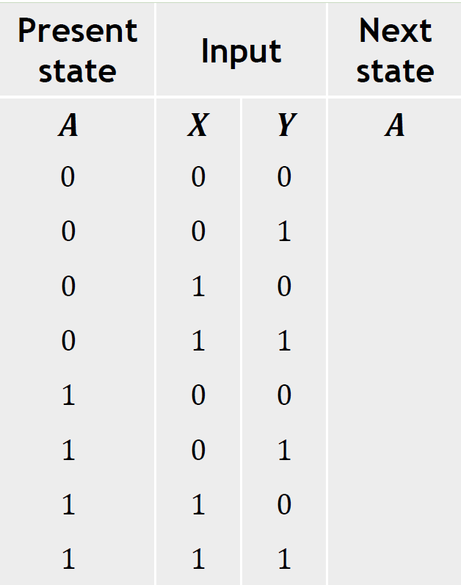
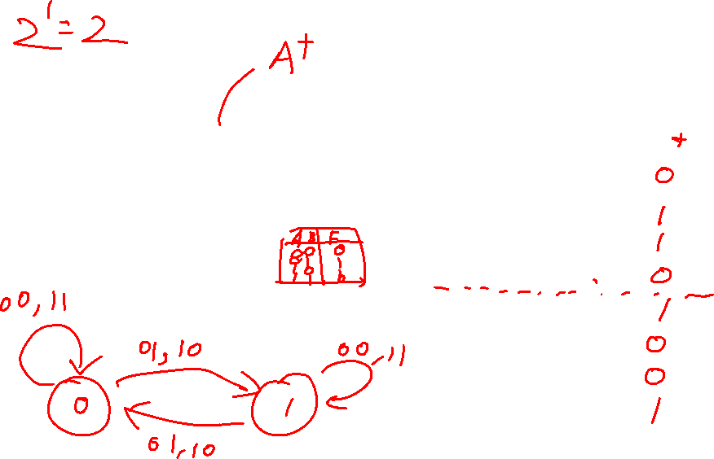
Analysis of D flip-flops
A’
State Diagram?

Slide 14
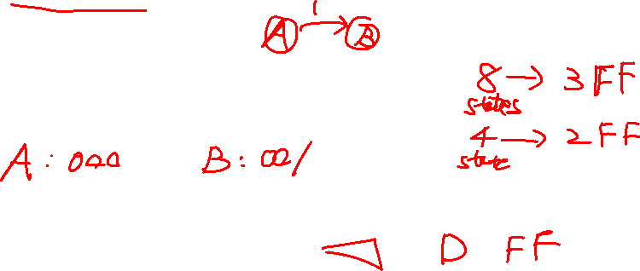
Design Procedure
1.Derive the state diagram from the word description and specifications of the desired operation
2.Reduce the number of states (introduced next week)
3.Assign binary values to the states
4.Obtain the binary-coded state table
5.Choose the type of flip-flops to be used
6.Derive the simplified flip-flop input equations and output equations
7.Draw the logic diagram

Slide 15
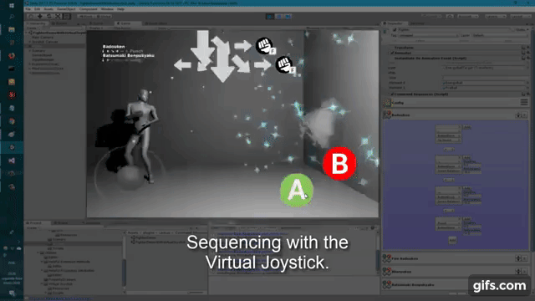

Sequence detector
Binary sequences are inserted at the beginning of a data frame or subframe emanating from a digital data processor. Sequence detectors are used in the decoding equipment to provide “flags” which indicate the beginning of a data block.

Slide 16
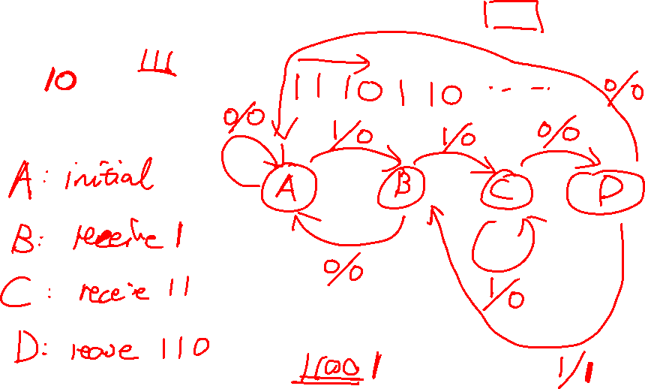
Design Example- Sequence recognizer
We need to design a circuit that detects a sequence 1101 in a string of bits coming from an input line (i.e. the input is in serial bit stream)
State diagram

Slide 18
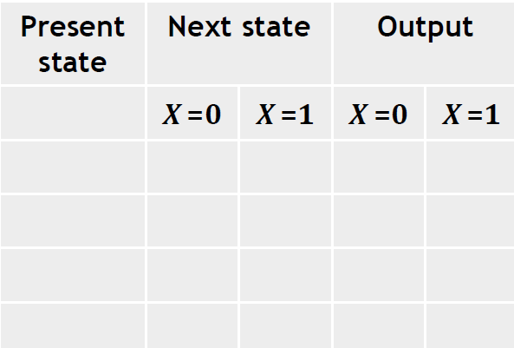
Design Example- Sequence recognizer
State table

Slide 19
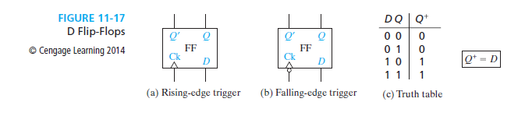
D Flip-Flop

Slide 20
Design Example- Sequence recognizer
Present state | Next state |  | Output
 | X =0 | X =1 | X =0 | X =1
00
01
11
10
For D flip flop: D=Q⁺
YZ
X
00 01 11 10
D
0
Y
1
YZ
X 00 01 11 10
YZ
X
00 01 11 10
D
0
F
0
Z
1
1

Slide 21
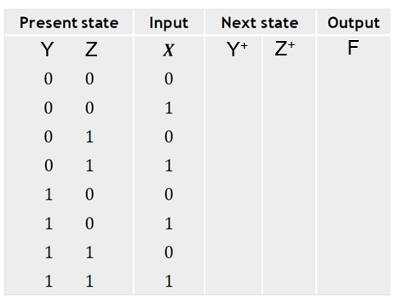
YZ
X
00 01 11 10
D
0
Y
1
YZ
X
00 01 11 10
YZ
X 00 01 11 10
F
0
D
0
1
Z
1

Slide 22
Design Example- Sequence recognizer
Boolean expression
𝑫_{𝒀} =
𝑫_{𝒁} =
𝑭 =
Logic diagram

